Slide 1

Predicting Football Player Goal Scoring Using AI
Sotia Koukou & Victoras Panayiotides
Professors: Pavlos Protopapas, Ignacio Becker
Mentors: Anshika Gupta, Nawang Thinley Bhutia

Slide 2
Problem Statement:
Predicting the number of goals a player, from the premier league, will score in an upcoming match
Importance of this prediction:
Predicting the number of goals a player is going to score in an upcoming match is a useful insight for the scouting department of the team.
Knowing the goals that will be scored in an upcoming match by a player will help setting up the starting XI and prepare the tactics of the match.
It can help manage the team's attacking players and help the scouting team make decisions on potential transfers.
It will assist fans to bet on players scoring in upcoming matches
Notes:
2nd bullet point: Also,
3rd bullet point: Moreover,
4th bullet point: Lastly,

Slide 3
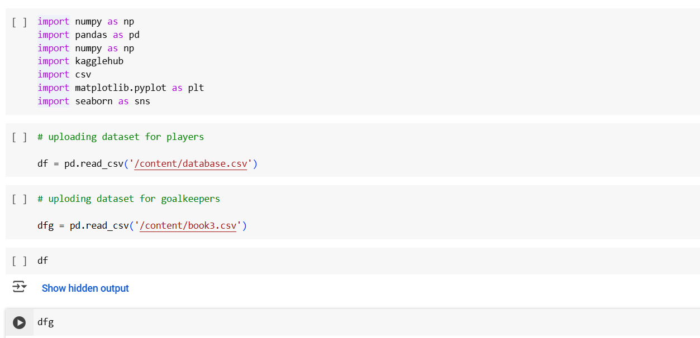
Import libraries and datasets
We imported the necessary libraries needed for the program, and used panda’s attribute ‘read_csv’ to upload the datasets
Notes:
Pics

Slide 4
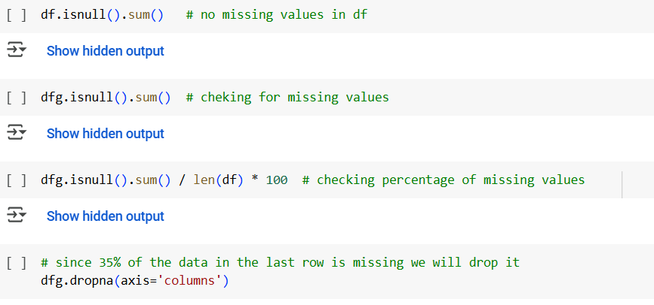
Removing Missing Values
We checked for missing values and removed them using the pandas attributes isnull(), and drop()
Notes:
Pics

Slide 5
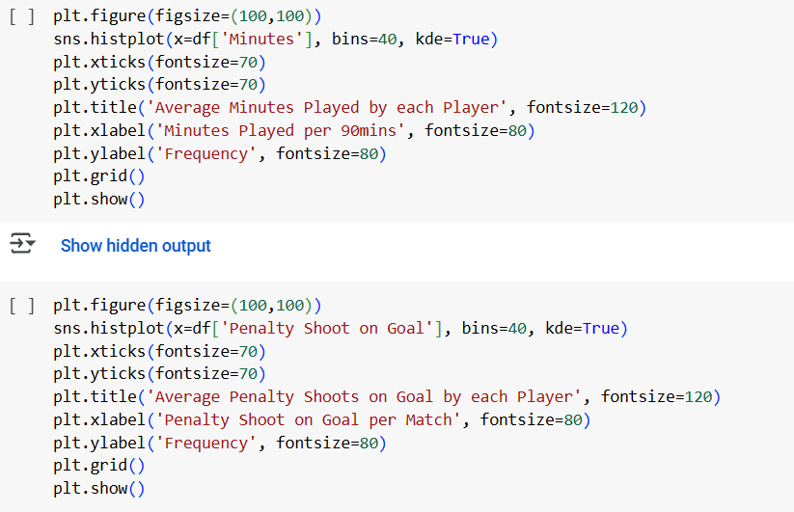
Visualize data
We visualized the data using histograms of seaborn and matplotlib libraries
.
.
.
Notes:
Pics

Slide 6
Data Visualization
We used histograms to visualise our data:
Notes:
Pics

Slide 7
Data Visualization
We used histograms to visualise our data:
Notes:
Pics

Slide 8
Data Visualization
We used histograms to visualise our data:
Notes:
Pics

Slide 9
Data Visualization
We used histograms to visualise our data:
Notes:
Pics

Slide 10
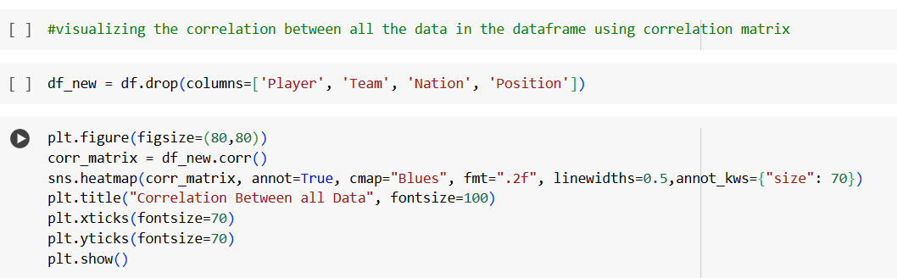
Visualize correlation between all data
We visualized the correlation between all the data in the DataFrame using correlation matrix
Notes:
Pics

Slide 11
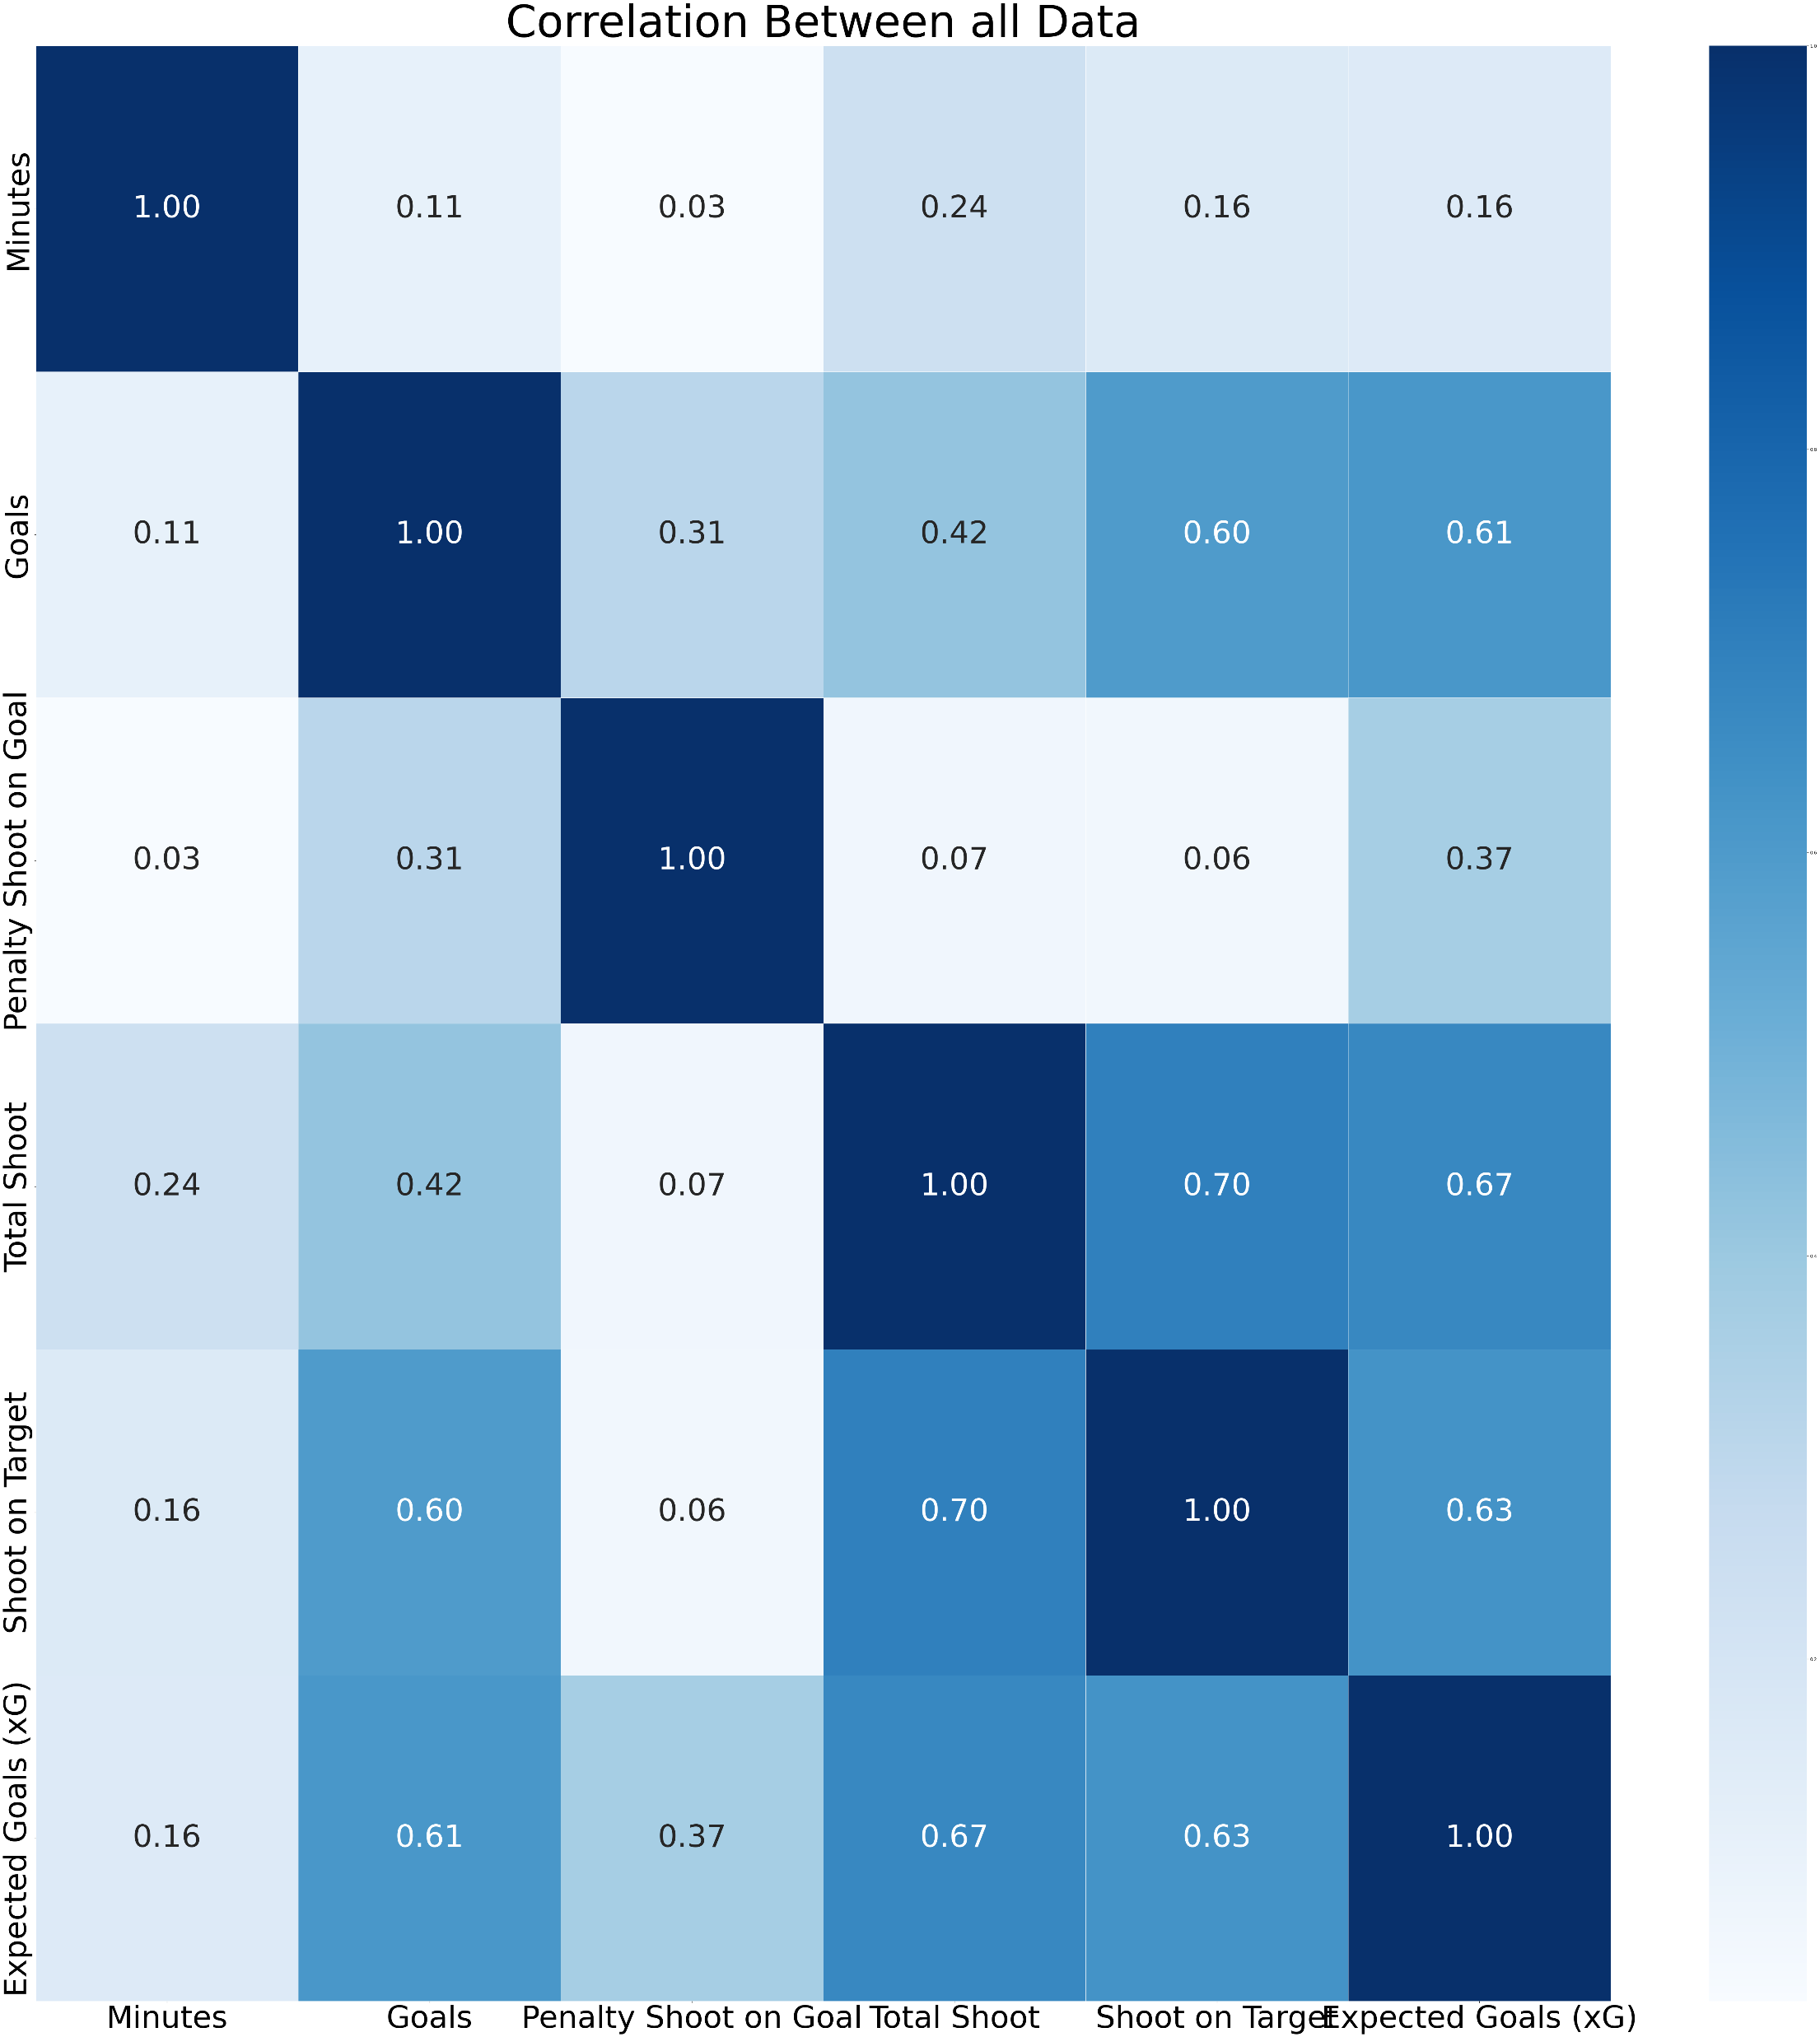
Visualize correlation between all data
Notes:
Pics

Slide 12
How are we going to solve the problem?
We will split our data into Training, Testing and Validation
We are planning on using the different models we believe suit our data e.g. logistic and polynomial regression.
We will choose the appropriate model depending on which one is more accurate and precise regarding our dataset using validation methods such as Lasso and Ridge regression

Slide 13
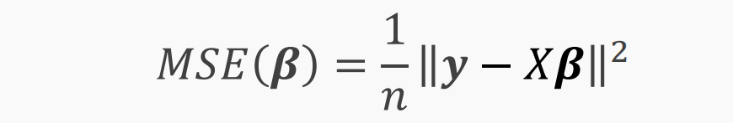
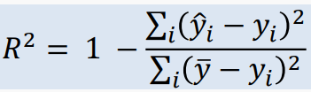
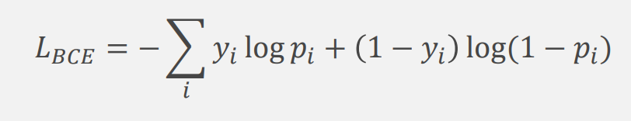

Model Evaluation
Matrices that we will use to evaluate our model include:
Mean Squared Error (MSE)
$R^{2}$ Score
Binary Cross Entropy

Slide 14
Thank you
for
your Attention

